Slide 1

Review of RUL Prediction
of
Data-driven method

Slide 2
RUL
RUL: Remaining useful life
Task: Use the measured data of the past several cycles to predict how many cycle life remained.
Multivariable time series prediction

Slide 3
Dataset
Dataset: MIT Dataset [1]
124 run-to-failure battery data
The data set mainly contains the continuously measured voltage, current, and temperature of each battery during every cycles.
In addition, it also contains the charge and discharge capacity value of each cycle, the number of cycle life of each battery, and other data that can be derived from the above.
[1] Severson, K.A., Attia, P.M., Jin, N. et al. Data-driven prediction of battery cycle life before capacity degradation. Nat Energy 4, 383–391 (2019). https://doi.org/10.1038/s41560-019-0356-8
[2] Zhang, Y. , et al. "Prognostics of battery cycle life in the early-cycle stage based on hybrid model." Energy 221(2021):119901.

Slide 4
Data-driven Methods
Machine Learning method
Based on statistics model
Deep Learning method
Based on neural network which is able to simulate the battery degradation function

Slide 5
Kinds of method
Machine Learning
SVM (Support Vector Machine)
Genetic Algorithm
Random Forest/Xgboost
Deep Learning
Long short term memory network (LSTM)
Convolutional neural network
Generative Adversarial Network (GAN)
Hybrid

Slide 6
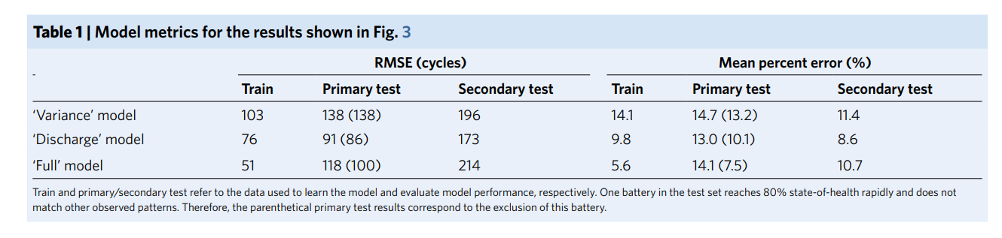
Overview of the method of the same dataset
Elastic Net
Advantage: Both L1 and L2 regularization is used to avoid overfitting; High Speed; Useful when features are related
Disadvantage: Relatively low accuracy; The function isn’t linear
Severson, K.A., Attia, P.M., Jin, N. et al. Data-driven prediction of battery cycle life before capacity degradation. Nat Energy 4, 383–391 (2019). https://doi.org/10.1038/s41560-019-0356-8

Slide 7
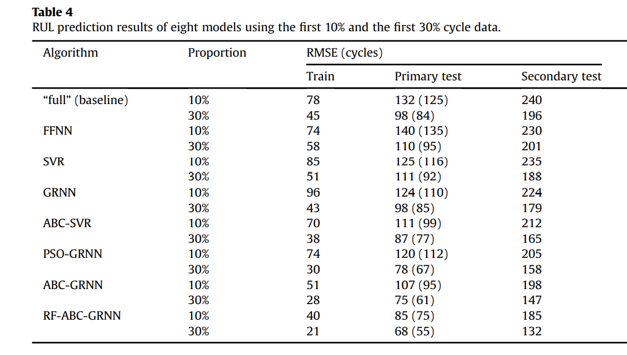
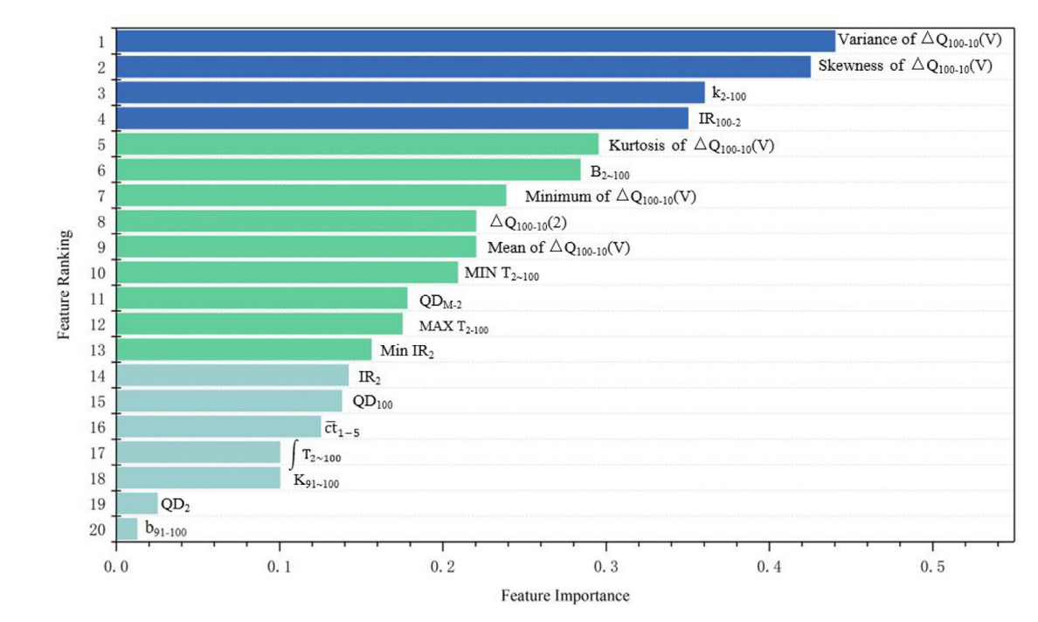
Overview of the method of the same dataset
Random Forest; Artificial Bee Colony; General Regression Neural Network
Advantage: Use ABC to find the parameters of the GRNN
Disadvantage: Knowledge Loss
[1] Zhang, Y. , et al. "Prognostics of battery cycle life in the early-cycle stage based on hybrid model." Energy 221(2021):119901.

Slide 8
Some thoughts
The reason why the algorithm does well on the first batch and doesn’t do well in the second and third batch is because they are from different sample space.
And the average life of the second test set is much larger than the other two set.
To improve the result, realign the dataset is necessary.

Slide 9
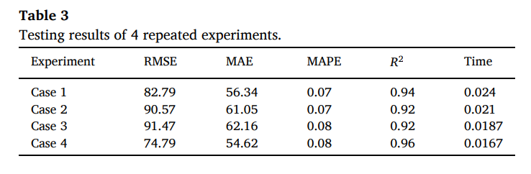
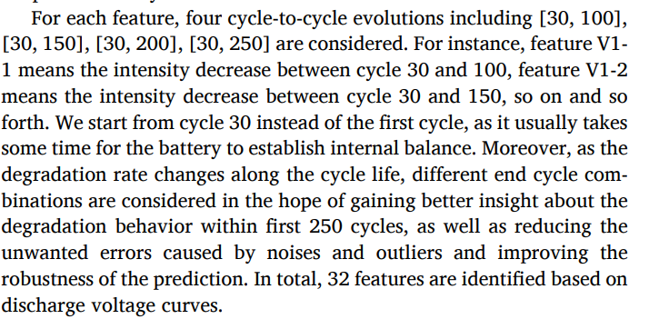
Overview of the method of the same dataset
GBRT (Gradient Boosting Decision Tree)
Advantage: Strong Generalization ability; High Speed
Disadvantage: Relatively low accuracy; Knowledge loss
Zhou D, Xue L, Song Y, Chen J. On-Line Remaining Useful Life Prediction of Lithium-Ion Batteries Based on the Optimized Gray Model GM(1,1). Batteries. 2017; 3(3):21. https://doi.org/10.3390/batteries3030021

Slide 10
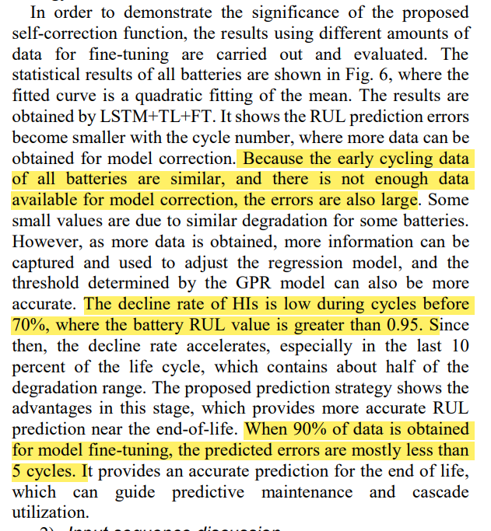
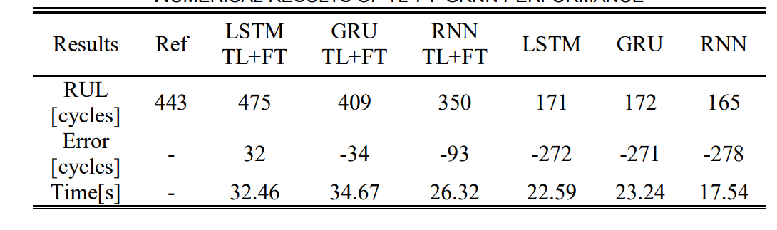
Overview of the method of the same dataset
Transfer Learning; Health Indicator; Gaussian process regression; LSTM
Advantage: HI; Self-correction; Fine-tuning
Disadvantage: It can’t give a correct RUL in the early-stage; When it comes to late stage, all kinds of method can achieve quite good result.
[1] Che, Y. , et al. "Predictive Battery Health Management with Transfer Learning and Online Model Correction." IEEE Transactions on Vehicular Technology PP.99(2021):1-1.

Slide 11
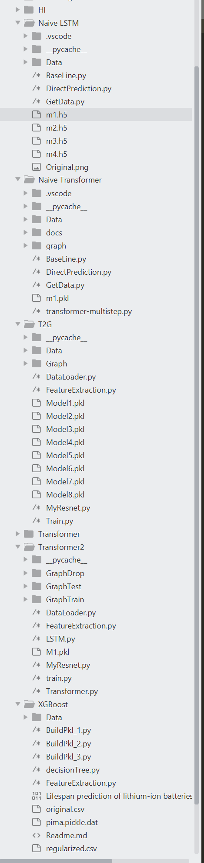
Summarize of my work
Feature Extraction
Recurring some of the method:
Xgboost
LSTM
Try something new:
Transformer
Auto Embedding
T2G

Slide 12
Time Series to Graph Algorithm (T2G)
Convert multi-variable time series to image and use CNNs for prediction
[1] given a similar idea to predict load
Difference:
Different method of converting time series to image
A more general idea of image with 20 channels instead of 3.
Different target: RUL/Load
We needs the advantage of parallelism of images, which isn’t mentioned in [1].
[1] Sadaei, H. J. , et al. "Short-term load forecasting by using a combined method of convolutional neural networks and fuzzy time series." Energy 175.MAY 15(2019):365-377.

Slide 13
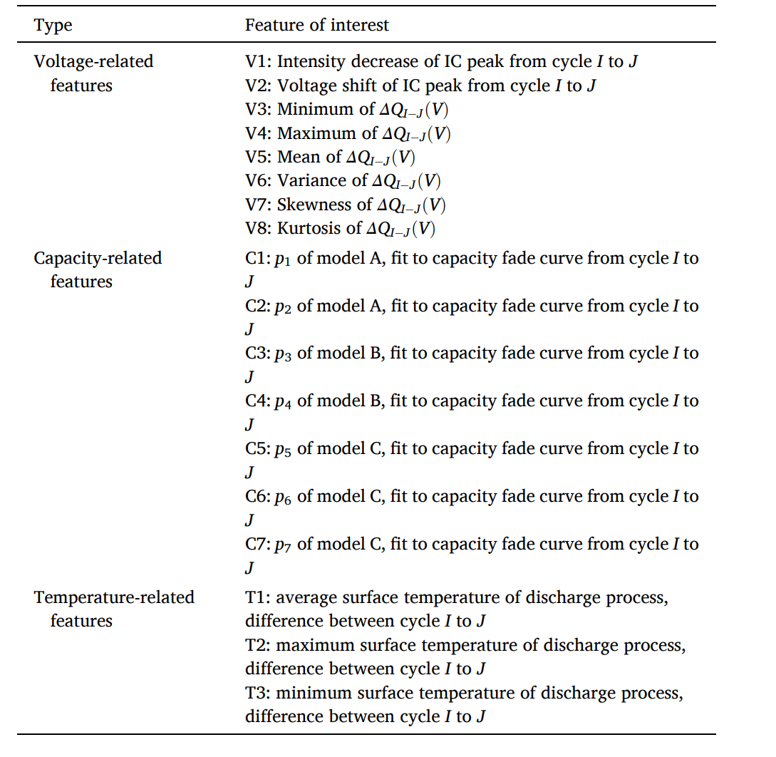
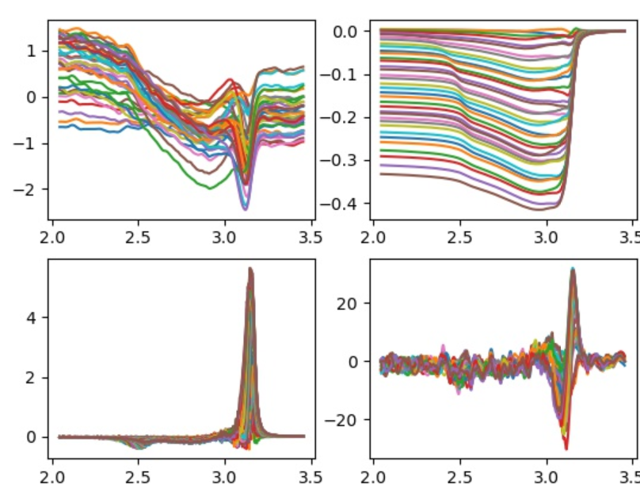
Feature Extraction
Follows [1]
Derive from DTDV and DQDV
Here each cycle of data is subtracted from the first cycle’s data, in order to minimize the difference between batteries.
Zhou D, Xue L, Song Y, Chen J. On-Line Remaining Useful Life Prediction of Lithium-Ion Batteries Based on the Optimized Gray Model GM(1,1). Batteries. 2017; 3(3):21. https://doi.org/10.3390/batteries3030021

Slide 14
Experiment Result
Both Xgboost and LSTM’s RMSE is about 100, which is larger than the author described in the paper.
Transformer doesn’t do well in the prediction part, both single-variable and multi-variable, the result is quite similar to LSTM.
Transformer may be better learning long-term dependency, but not short.
The test of auto-embedding fails and leads to enormous overfitting.
The test result of T2G is inspiring, with train RMSE about 30 and test RMSE about 80

Slide 15
Future Work
Improve the T2G method (Main)
Improve data quality (Main)
More Features
Change the network model
Hyperparameters
Improve the Transformer
Restrict by the amount of data
Classification first

Slide 16
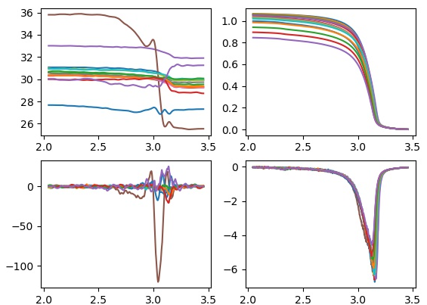
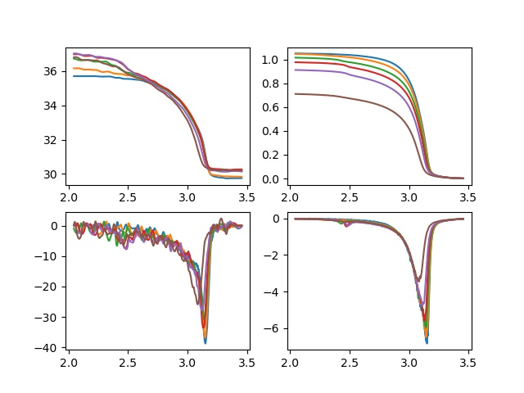
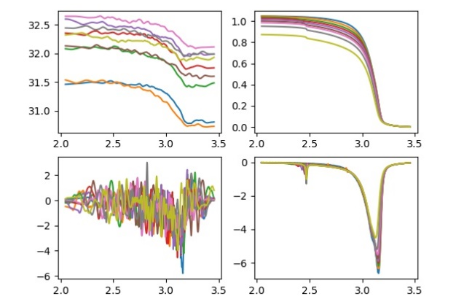
My recent work: Data washing
Some cycle of data in the MIT dataset have great noise or not the follow the trend.
V-T; V-Capacity; V-DT; V-DQ

Slide 17
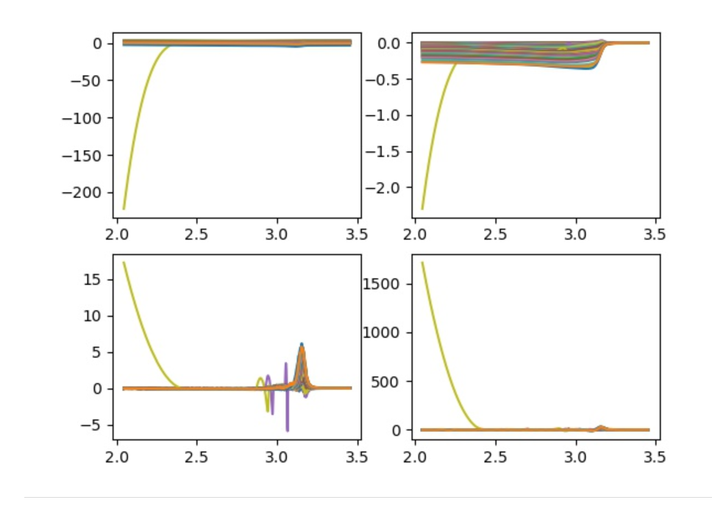
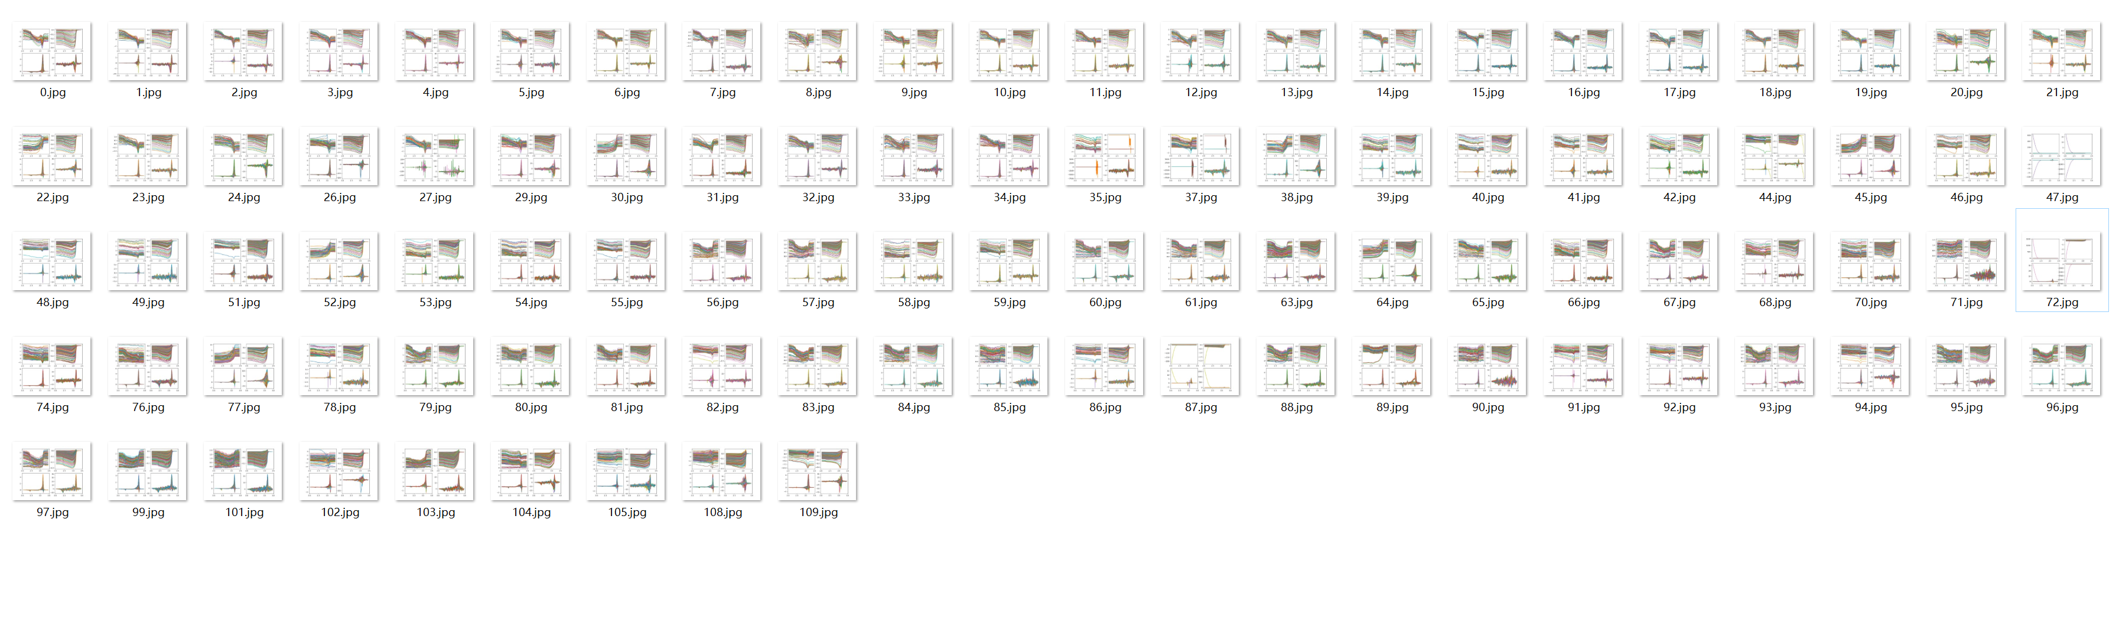
My recent work: Data washing
Outliers/Abnormal data may influence the algorithm a lot
Especially after the regularization such as MIN-MAX scaler
Usually for each battery there will be several cycle’s data went wrong

Slide 18

Thank you!

